Slide 1


Adaptive Driving Assistance System
Supervised by
Prof. Miloni Ganatra
Department of Electronics and Communication Engineering
Date: 26th February,2022
Kritarth Chauhan (IU1841090006)
Vandit Patel (IU1841090013)
Aakash Patwa (IU1941091032)
Semester: 8th

Slide 2
Kritarth/Vandit/Aakash/ECE/Sem8/2022
Motivation behind the Project
Recent advancements in automation of vehicles and machine vision technology.
Enhancements in the safety features in automobile industry.
Compared to traditional transportation features, Adaptive driving assistance system is superior in ensuring passenger safety, and improving driving control.

Slide 3
Kritarth/Vandit/Aakash/ECE/Sem8/2022
Project summary
Adaptive Driving Assistance system is a group of electronic technologies that assist drivers in driving functions.
It employs a variety of sensors in conjunction with machine learning to aid drivers in avoiding errors in judgement.
Headlights will be controlled based on the amount of light available, for better visibility for the driver.
Making decisions based on traffic signal status detection.

Slide 4
Kritarth/Vandit/Aakash/ECE/Sem8/2022
Block diagram
Draw the schematic diagram of your project
Incase of hardware project , show the all blocks of whole system.
for simulation ,mention the simulation tool and why that tool?
circuit diagram of each blocks and circuit diagram of whole
system
incase of software project, Draw flow chart and frame architecture
mention the software platform.

Slide 5
Kritarth/Vandit/Aakash/ECE/Sem8/2022
Technical Skills Required
Programming based skills : Python, Arduino IDE, Raspbian, OpenCV.
Hardware based skills include : Interfacing with Raspberry Pi and Arduino Board , integrating sensors and DC motor controller Unit.

Slide 6
Work done so far
Hardware Sourcing
Camera interfacing with Pi board
Initial software implementation
Github repository integration
YOLO weight file generation

Slide 7
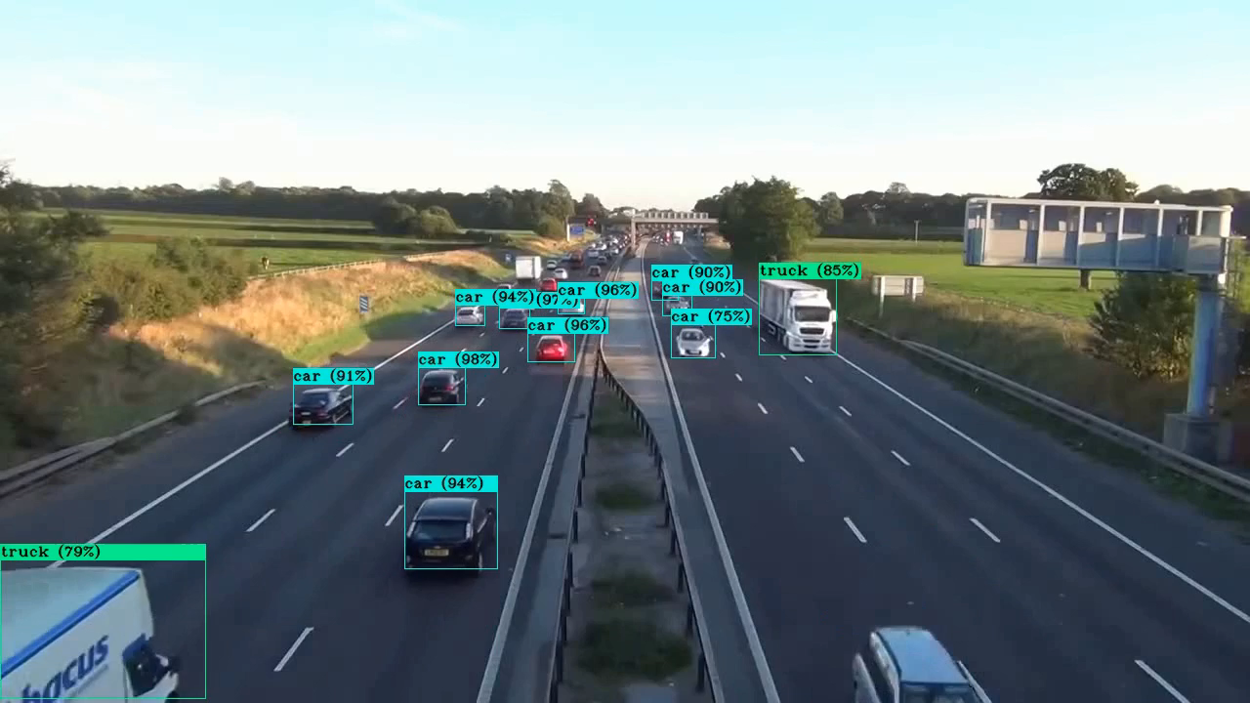
Sample Simulation

Slide 8
Why YOLO ?
Prior detection systems repurpose classifiers or localizers to perform detection. They apply the model to an image at multiple locations and scales. High scoring regions of the image are considered detections.
A single neural network is applied to the full image, this network divides the image into regions and predicts bounding boxes for each region.
Advantages over classifier-based systems:-
It looks at the whole image at test time.
It also makes predictions with a single network evaluation.
More than 1000x faster than R-CNN and 100x faster than Fast R-CNN.

Slide 9
Kritarth/Vandit/Aakash/ECE/Sem8/2022
Final Demonstration
Mode of demonstration:
Functional hardware prototype.
Software Simulation with results.
Graphical respresntation of data.
The particular demonstration will be given on campus, in whichever laboratory assigned by the University.

Slide 10
Kritarth/Vandit/Aakash/ECE/Sem8/2022
Approximated cost of project
Sr. No | Components | Approximate Price
1 | Raspberry Pi 4b | 4200
2 | Raspberry Pi Camera Module | 2000
3 | 10000 mAh Power Bank | 800
4 | Car Chassis | 750
5 | Arduino Uno | 600
6 | 16gb Memory Card | 400
7 | L298N Dual H Bridge | 300
Total |  | 9050

Slide 11
Kritarth/Vandit/Aakash/ECE/Sem8/2022
Applications
The implementation of cameras in the vehicle involves a new AI ​​function that uses sensor fusion to identify and process objects.
Sensor fusion/integration, similar to the human brain process information, combines large amounts of data with the help of image recognition software.
It can analyse streaming video in real time, recognize what the video shows, and determine how to react to it. Real time decision making
Forward collision warning/brake assistance
Forward collision warning systems alert drivers of an impending collision with a slower moving or stationary car in front of them.

Slide 12
References
Yoshida, Tatsuya, Hiroshi Kuroda, and Takaomi Nishigaito. "Adaptive driver-assistance systems." Hitachi Review 53.4 (2004): 213.
Gietelink, Olaf, et al. "Development of advanced driver assistance systems with vehicle hardware-in-the-loop simulations." Vehicle System Dynamics 44.7 (2006): 569-590.
Wagner, Marco, Dieter Zöbel, and Ansgar Meroth. "An adaptive Software and Systems Architecture for Driver Assistance Systems based on service orientation." International Journal of Machine Learning and Computing 1.4 (2011): 359-365.
H. Inoue, "Research into ADAS with driving intelligence for future innovation," 2014 IEEE International Electron Devices Meeting, 2014, pp. 1.3.1-1.3.7, doi: 10.1109/IEDM.2014.7046962.
Redmon, Joseph & Farhadi, Ali. (2018). YOLOv3: An Incremental Improvement.

Slide 13
Thank You !

